Slide 1
TETANUS “Lockjaw”
Paula Stagg, RNMN WH IPAC Specialist
Tracey Reid, RN WH ICP

Slide 2
Goals
History of Tetanus
Clostridium tetani
Epidemiology
Clinical Features and Diagnosis
Medical Management
Vaccination
NL rates
WH case

Slide 3
History of Tetanus
Clinical descriptions date back to 5th century
Discovered in 1884 by Carle and Rattone
Injected pus from a fatal human case into animals
Nicolaier (1884) produced tetanus in animals with injection of soil samples

Slide 4
History of Tetanus
1889 Kitasato reported the toxin could be neutralized by specific antibodies
1897 Nocard demonstrated protective effect of passively transferred antitoxin in humans
WWI first time used for treatment and prophylaxis.

Slide 5
History of Tetanus
Early 1920’s Ramon developed a method to inactive tetanus toxin with formaldehyde
1924 Descombey developed tetanus toxoid
WWII fist wide spread use of tetanus toxoid

Slide 6
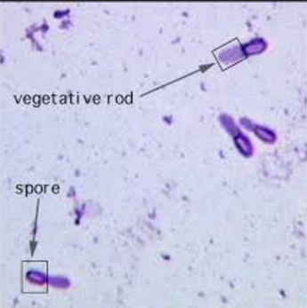
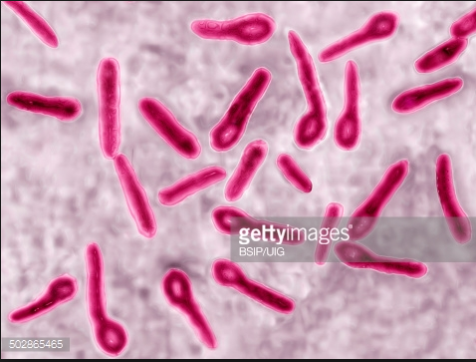
Clostridium tetani
Slender, gram-positive, anaerobic rod that may develop a terminal spore, giving it a drumstick appearance

Slide 7
Clostridium tetani
Organism is sensitive to heat and cannot survive in the presence of oxygen
Spores are very resistant to heat and usual antiseptics (found in soil and animal feces)

Slide 8
Clostridium tetani
Toxin producing:
Tetanolysin (unknown effects on humans)
Tetanospasmin-neurotoxin which causes the clinical manifestations of tetanus
One of the most potent toxins known
Human lethal dose is 2.5 nanograms(ng) per Kg of body weight.

Slide 9
Epidemiology
Occurrence is worldwide
Found in soil and intestinal tract of animals and humans
Primarily transmitted by contaminated wounds
May be transmitted through surgery, burns, deep puncture wounds, crush wounds, otitis media, IV drug use, dental infection, animal bites, abortion, and pregnancy
Not transmitted person to person

Slide 10
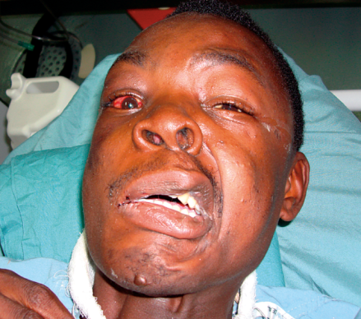
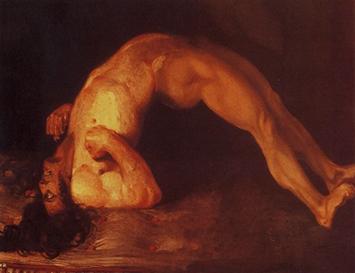
Clinical Features
Enters body through a wound
Spores germinate (incubation 3-21 days)
Produce toxins which are spread to CNS via blood and lymphatics
Toxin interferes with neurotransmitters causing unopposed muscle contraction and spasm.

Slide 12
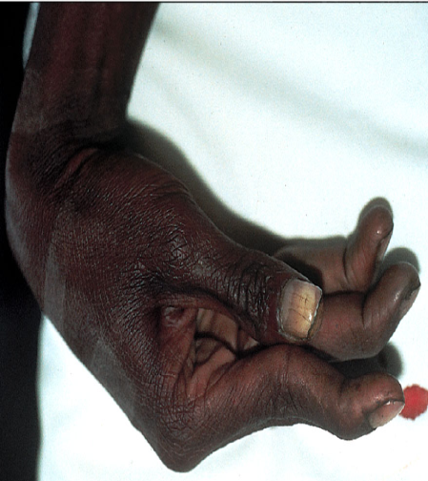
Diagnosis
No laboratory testing available (tetanus is ubiquitous in the environment)
Clinical manifestations in conjunction with known exposure and poor vaccination (4 known types)
Local tetanus- uncommon: persistent contraction of muscles in the same anatomic area as the injury

Slide 13
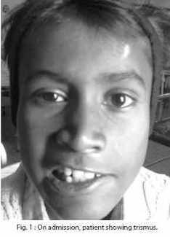
Diagnosis
Cephalic tetanus- rare form, occurs for otitis media or crush head injuries
Generalized tetanus- most common
Trismus aka: Lockjaw
Stiffness of the neck
Difficulty swallowing
Rigidity of abdominal muscles
May also include: fever, sweating, increased BP, rapid heart beat
Complete recovery may take months

Slide 14
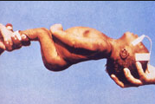
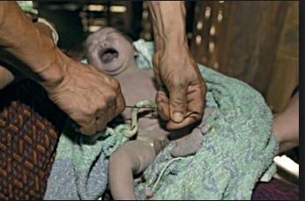
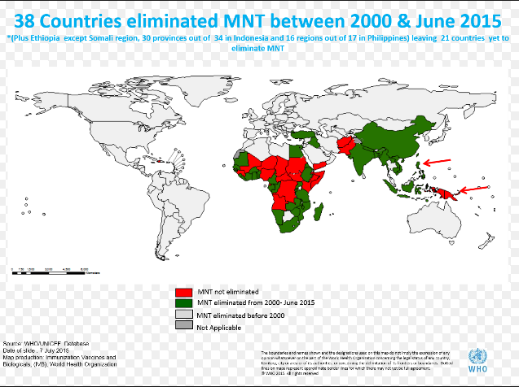
Diagnosis
Neonatal Tetanus: generalized form of tetanus occurring in newborns
Infant lacks passive immunity because mother not vaccinated
Occurs through infection of the unhealed umbilical stump, usually when cord cut with unsterile instrument
Higher risk in developing countries

Slide 15
Treatment
Clean wound-antibiotics NOT recommended
Supportive therapy for spasms
Airway management critical
Tetanus Immune Globulin + or - vaccination
*500 units “usual dose” (see next slide for PHAC and CDC Table of recommendations)
*Not our experience!

Slide 16
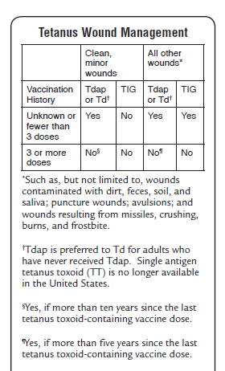

Slide 17
Vaccination
Prevention is best
Vaccinate with a minimum of a primary series.
Adults should have boosters every 10 years with Td or Tdap*
Only Vaccine preventable disease that is NOT contagious-therefor no heard immunity.
Review to 2007 only 1 case of Tetanus reported.

Slide 18
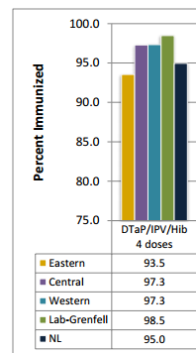
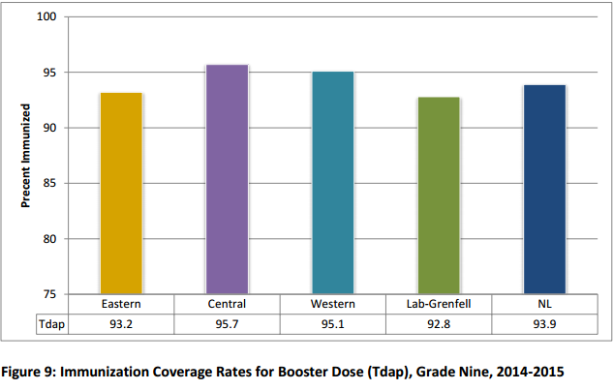
NL Vaccination Rates

Slide 19
WH case
60 year old male presented to E.R. with difficulty swallowing & increasing neck stiffness for the last few days that started to spasm
No medications, no known allergies
Decreased R.O.M. in his neck
Client stated last tetanus was 20 years ago

Slide 20
WH Case Cont….
Client reported working with metal 1 week ago & a piece of metal pierced his index finger. Dark area noted, suggestive of a foreign object in his finger
Treated with local debridement
3,000 units of Tetanus Immune globulin(TIg), Tdap vaccine, IV Flagyl given & Diazepam for spasms

Slide 21
WH Case Cont…..
Transferred to ICU until clinically stable
Transferred to the floor after 4 days
Discharged the day after
PHN to follow up with Tetanus vaccines

